Slide 1
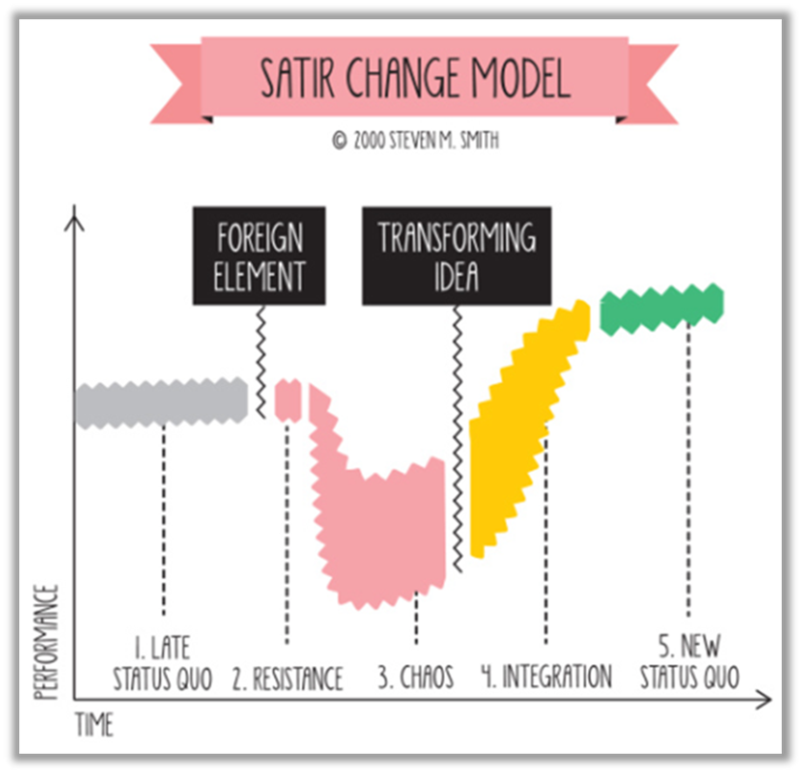
The Satir Change Model—Siemans’ Kalwa Plant
Stage | Events
Late status quo | [describe what this looked like]
FOREIGN ELEMENT | [what was it? – describe]
Resistance | [describe how this manifested]
Chaos | [describe how this manifested]
TRANSFORMING IDEA | [what do you think this was? – a variety of possible answers – describe]
Integration | [describe how this manifested]
New Status Quo | [describe how this manifested]

