Slide 1
Field Education
Introduction to Your Field Education Team at Widener

Slide 2
Field Education
Signature Pedagogy
Where do I find information about Widener’s field program
MSW Student Policy Manual
Field Education Website: https://apps.exxat.com/public/steps/Widener-SW/Home
Information will be sent to you from the field department each semester to your Widener e-mail

Slide 3
Michelle Brandt, LSW Director of Field Education
Meet your Field Team
My commitment to the social work profession led to my interest in working with students in the field education setting. My role as Director of Field Education at Widener University allows me the privilege of introducing social work students throughout the country to the exciting field of social work.
“What you do makes a difference, and you have to decide what kind of difference you want to make.” ― Jane Goodall

Slide 4
Lisa Allen, LSW Assistant Director of Field Education
Meet your Field Team
It has been my privilege and honor to work in the social work field for the last 25 years. Whether it was with children and families involved in the child welfare system, vulnerable seniors in the community, or folks involved in the criminal justice system, I strived to support my clients as they worked to overcome whatever obstacles were present in their lives.
Social work is such an important profession because we not only focus on treating our individual clients with a trauma-informed, strengths-based approach, but we also understand the importance of identifying and challenging the systematic injustices that exist for them as well. That is what makes social work different from other helping professions.
Although I had worked with students throughout my career, it was only 6 years ago that I entered the world of social work education. In my role as an Assistant Field Director, I have been able to contribute in a larger way to the training of the next generation of social workers. That is something that I am very proud of.

Slide 5
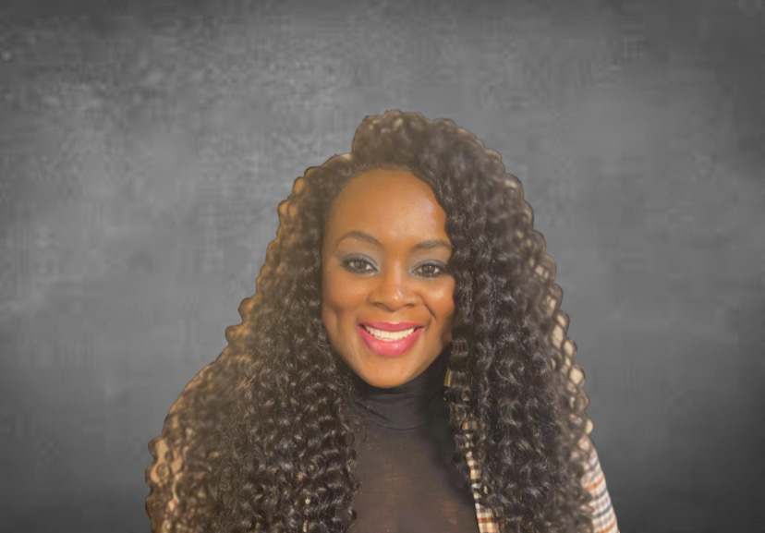
Tangela Harden, LSW Assistant Director of Field Education
Meet your Field Team
Service is the rent we pay for the privilege of living on this Earth
~ Shirley Chisholm
It is through social work that I give back to the Human race. I am so very proud to be a part of a profession that contributes to society in such a big way. We are a group of professionals that understand the importance of human relations despite our differences. We take up causes and challenge society in a way that hopefully creates a better space for each of us to explore, nurture, and share our individual talents. I am grateful to be a part of a Field Team that is supporting and shaping the next generation of Social Workers who will boldly carry the torch of pushing our society to a more equitable and just place for all.
If you have come to help me you are wasting your time, but if you have come because your liberation is bound up with mine, then let us work together~ Lilla Watson

Slide 6
Tina Radin, LSW Assistant Director of Field Education
Meet your Field Team
I am excited to be a part of the field education team at Widener for many reasons. Field education is an integral part of the social work education experience and entirely necessary to the development of a strong understanding of social work ethics and practice.
My own field placement experience provided the most profound and humbling learning opportunity and was critically important to my development as a social worker. The ways in which we weave our own values, beliefs, and experiences into our work can be impactful in both constructive and destructive ways. Field education is a place to learn to harness the power in who we are as individuals, and direct it towards work that uplifts, empowers, and strengthens the dignity of who we serve.

Slide 7
Regina Rothe, LCSW Assistant Director of Field Education BSW Field Director
Meet your Field Team
"Give me a place to stand, and I will move the earth.”
-Archimedes
I believe social workers "move the earth," and field education at Widener offers you a solid "place to stand."
After many years in the field, I look forward to now being a part of your social work education journey.
(And yes, mine continues, too!)

